Slide 1











.NET Conference 2023
Roma 10/03/2023

Slide 2
SPONSOR

Slide 3


Slide 4


Slide 5


Slide 6
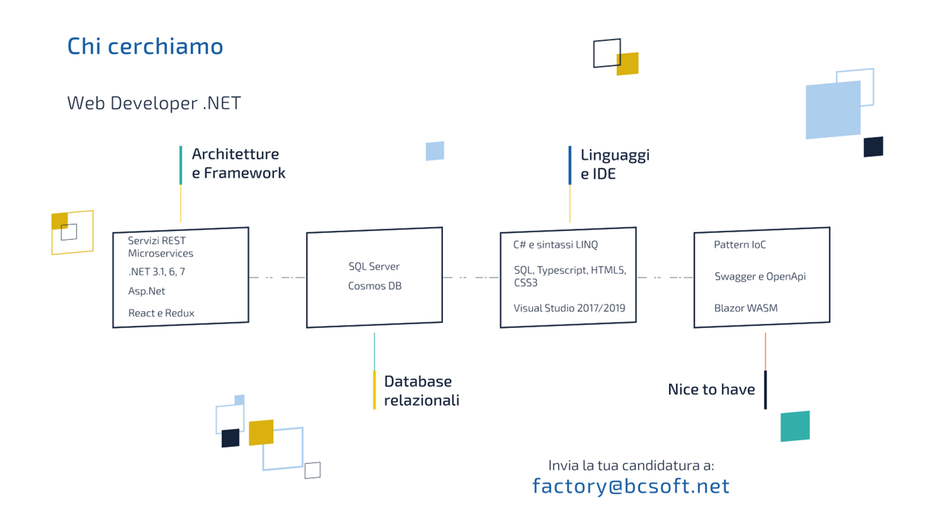

Slide 7


Slide 8


Slide 9


Slide 10


Slide 11
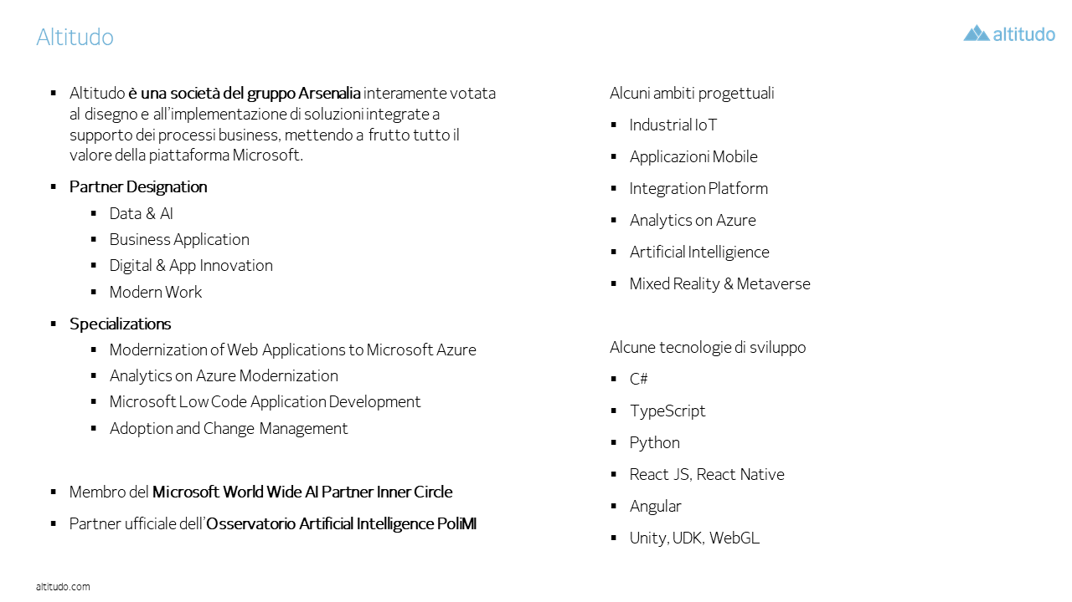

Slide 12


Slide 13


Special Discount

Slide 14


Slide 15


Slide 16


Slide 17


Slide 18


Slide 19


Slide 20

SPONSOR
Event Partner/Supporters

Slide 21
SPONSOR

